Slide 1
MASS IMAGING SPECTROMETRY
IN DETECTING
TUMOR HETEROGENEITY

Slide 2
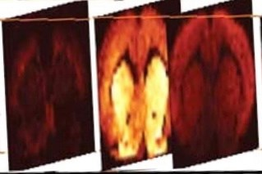
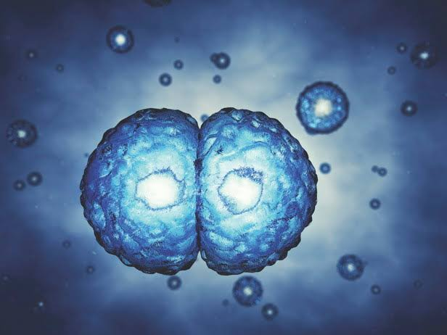
Imaging Mass Spectrometry
(MSI)
Tumor Heterogeneity
Causes:
“A picture worth a thousand words.”
Ultraviolet Radiations
Smoking
Genetic Factors

Slide 3
Table of Contents
01
02
03
INTRODUCTION
OBJECTIVES
INSTRUMENTATION
04
IMAGING
TECHNIQUES

Slide 4


INTRODUCTION
NEW CASES
DEATHS
Cancer is one of the leading causes of death.

Slide 5
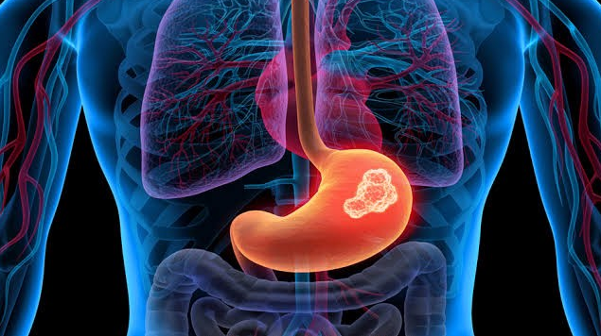
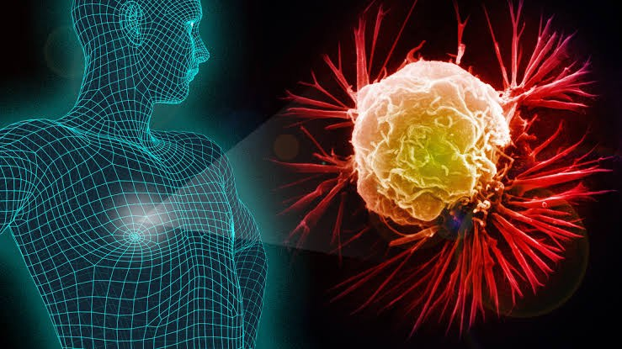
Contents of This Template
BREAST CANCER
GASTRIC CANCER

Slide 6
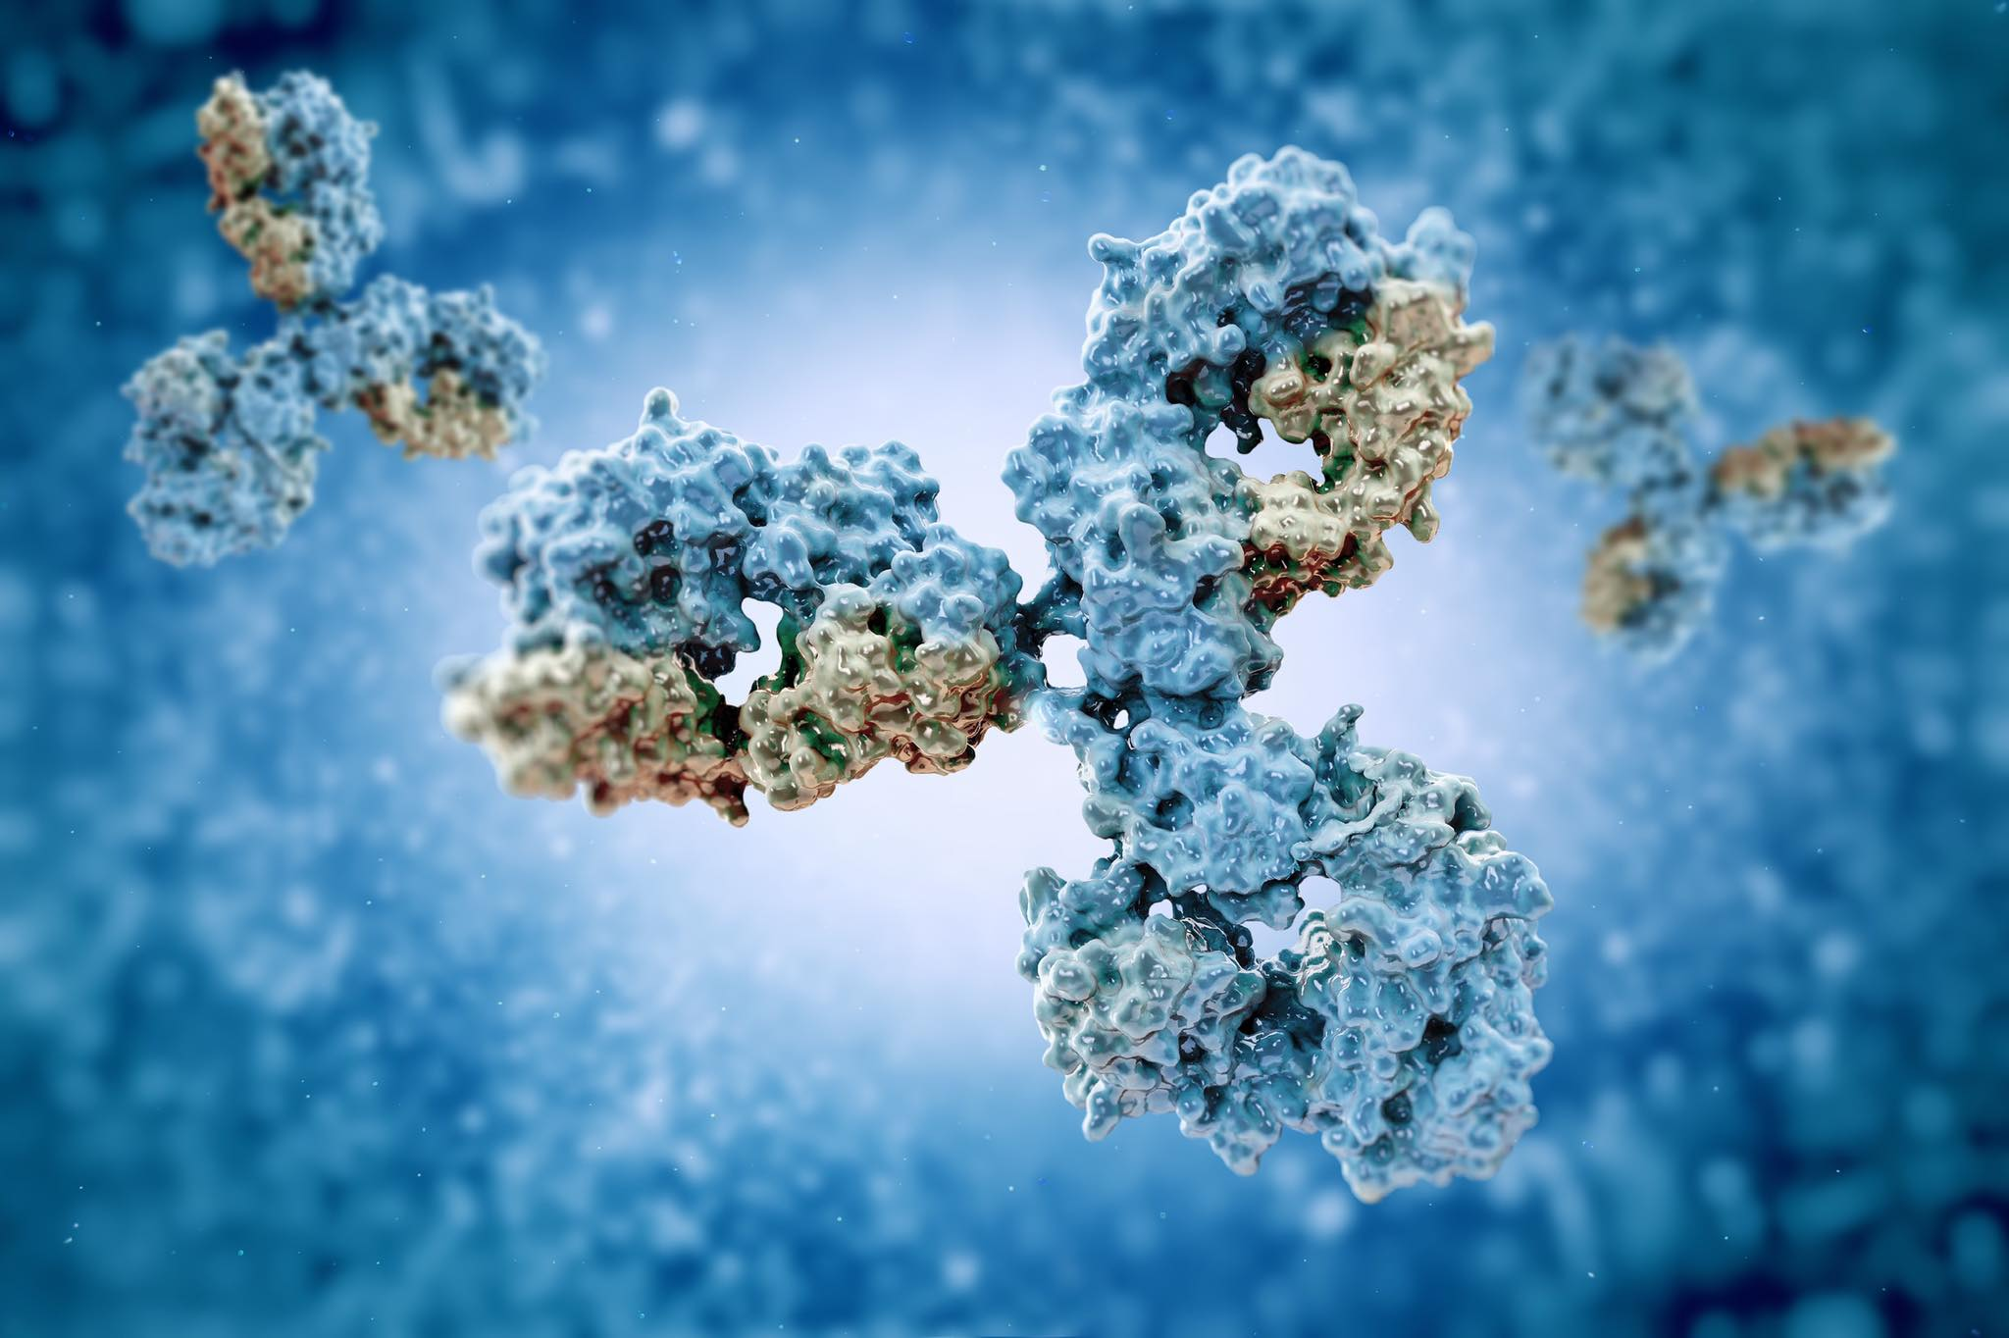
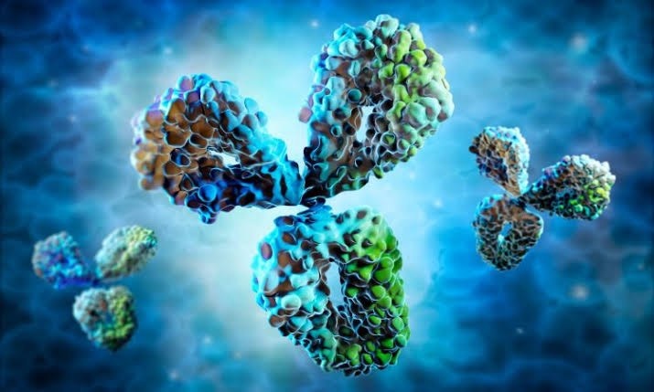
Contents of This Template
0
2
OBJECTIVES

Slide 7
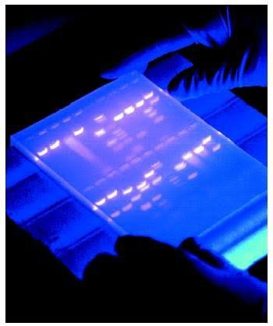
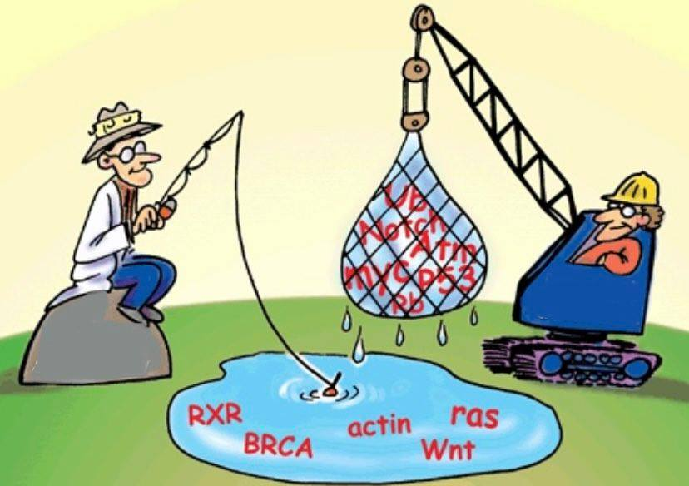
PROTEOMICS
This universal technique analyzes complex protein samples by isolation of the proteins from cell lysates by:
Electrophoresis
Biochemical Fractionation

Slide 8

Early Diagnosis
Early diagnosis leads to faster and easier treatment.

Slide 9
PROTEOMICS
PROTEIN ANALYSIS
PROTEIN QUANTIFICATION
PROTEIN FUNCTIONS
PROTEIN LOCALIZATION
PROTEIN SEPARATION
PROTEIN ACTIVITIES

Slide 10
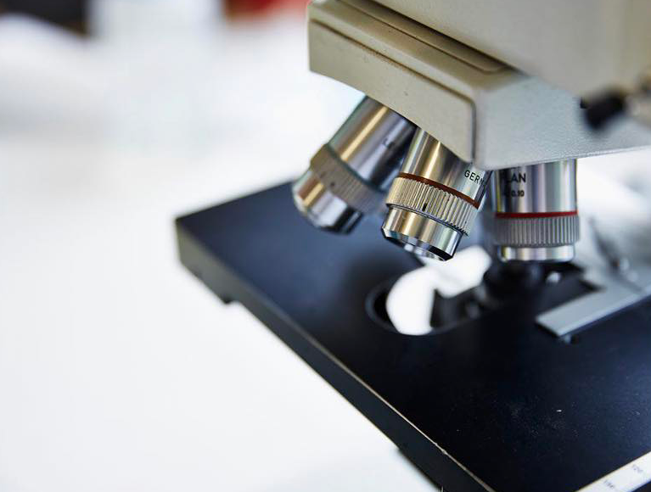
0
3
IMAGING
TECHNIQUES

Slide 11
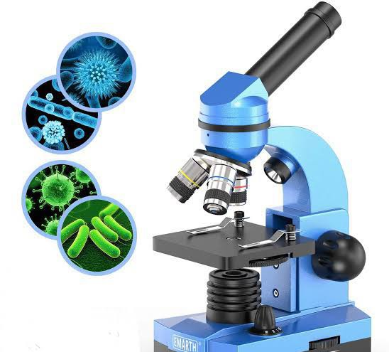
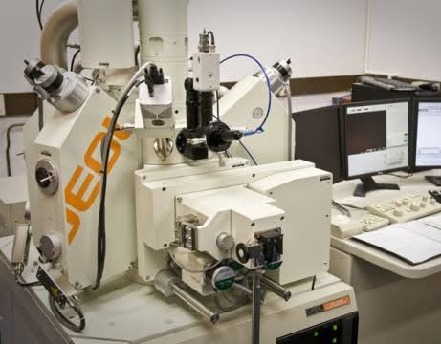
1. MICROSCOPE
2. MICROPROBE

Slide 12
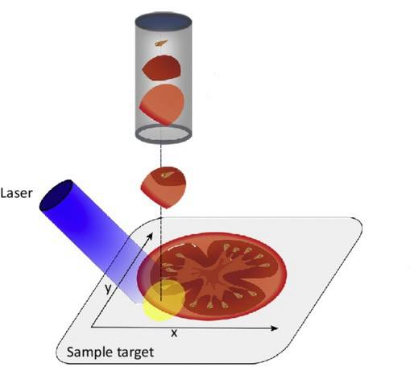
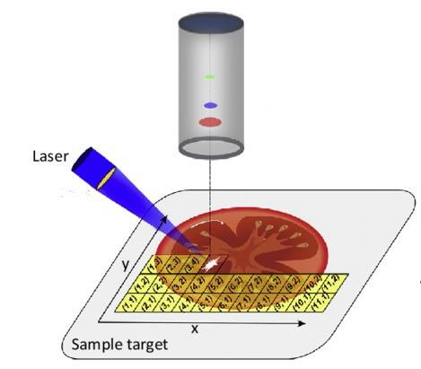
1. MICROSCOPE
2. MICROPROBE
Focused Laser beam.
Simplest and most common technique.
Unfocused laser beam.

Slide 13
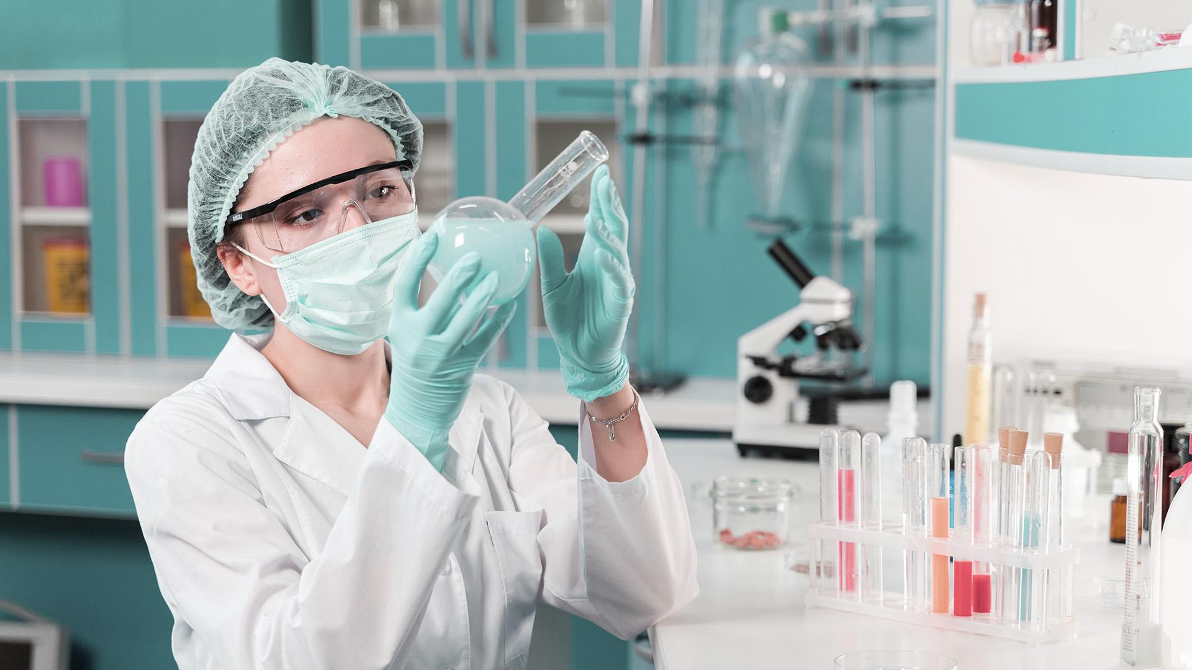
04
INSTRUMENTATION

Slide 14
MATRIX-ASSISTED LASER DESORPTION/IONIZATION
(MALDI)
1st | Matrix | Sample is mixed with suitable matrix material.
2nd | Laser | A pulsed laser irradiates the sample causing desorption sample and matrix material.
3rd | Ionization | Finally, the analyte molecules are ionized.

Slide 15
MALDI

Slide 16

MALDI Summary

Slide 17
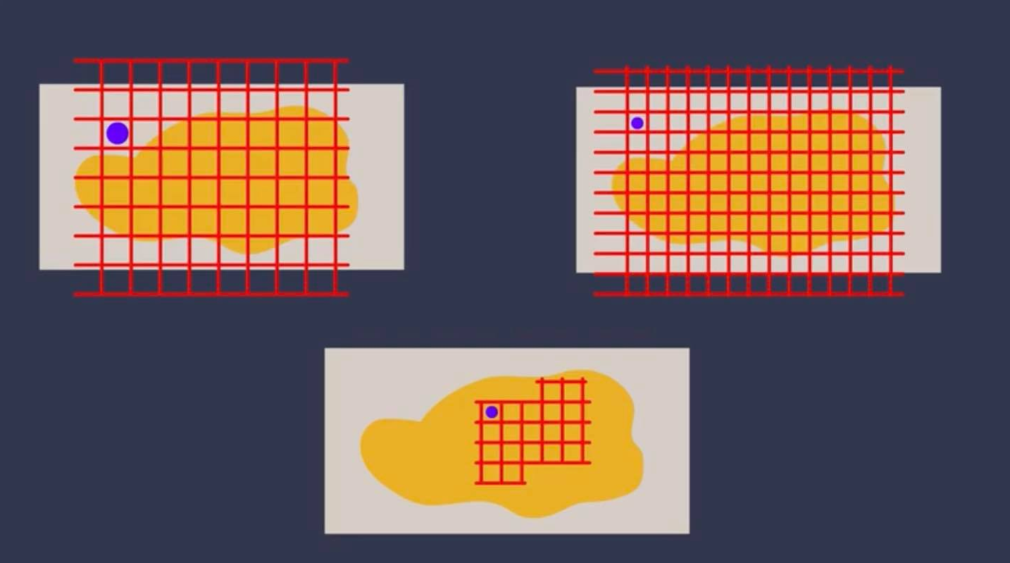
MALDI and Microprobing

Slide 18
Thank you!

